Slide 2
DCAF: A Framework for Efficiently Developing Robust Control Applications
Burt Snover
Sr. Technical Marketing Specialist
Embedded Systems - CLA

Slide 3
Agenda
Distributed Control and Automation Framework (DCAF) Overview
Benefits of Using the Framework Throughout a Project
  Design
  Develop
  Validate
  Deploy
  Maintain
Common Questions
Next Steps
Notes:
This presentation will serve as an overview of the framework, will show a demo of the features, and will summarize the key framework benefits throughout the lifecycle of a project. Deeper technical knowledge of the framework can be found by referencing additional information found in the community.

Slide 4
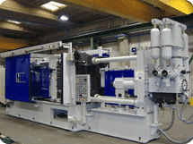
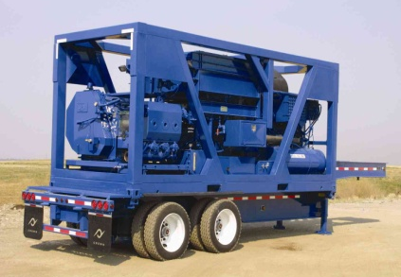


Programming Embedded Control Applications is Hard
RT, FPGA, and User Interface programming
Distributed I/O and execution
High cost of failure
  Execution guarantees
  Understand failure root cause
High availability
System commissioning
Software updates and deployments
Multi-developer teams
Plus the crazy things it actually has to do!
Manufacturing Machines
Heavy Machinery & Equipment
Power Conversion Equipment
Medical Devices
Notes:
RT, FPGA, and UI programming can vary widely in style and knowledge requirements. Being proficient in all three takes both training and experience.
Distributed I/O and execution means a variety of communication protocols to learn. CAN, EtherCAT, UDP, TCP, AMQP, and possibly even the upcoming IIoT protocols may all be involved.
Execution guarantees require knowledge of deterministic programming techniques. Understanding why something failed requires built-in diagnostics and good error handling.
High availability means programs need to be able to run for months or longer without stopping. They also need to be able to recover from a failure automatically.
No two machines are exactly the same. Tuning, features, parameters often need to be tweaked during setup. This requires extensive and powerful parameterization, which ideally is built into the code before it is needed.
These machines are typically built to last. Development teams need a strategy for how to get updates to the code. How do bug fixes or new features get deployed reliably?
These systems are often complex enough and with a tight enough timeline to require multiple software developers. Multi-developer teams don’t work efficiently overnight, and require training and process investments to really flourish.
To top it all off, the functionality for these machines in terms of their primary tasks are complex and getting even more so. It also needs to do those tasks better than the competition.

Slide 5

The Next Phase in the Evolution of System Engineering Tools
Machine Control Reference Architecture (MCRA)
  CVT, CCC, AMC, STM, CIE, etc.
Released NI Week 2016!
DCAF
Tag Bus Data Framework (TBDF)
Notes:
While brand new in this particular format, these tools have been years in the making and have been repeatedly proven on a wide variety of applications.
The CVT, CCC, AMC, etc. libraries from the Machine Control Architecture will still be available, but the architecture will be deprecated.
The Tag Bus Data Framework (TBDF) and corresponding community will be completely deprecated. The final TBDF package will still be available for those that want it.
Some, but minimal, work may be required to update applications built with the previous tools.

Slide 6

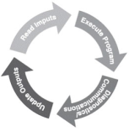
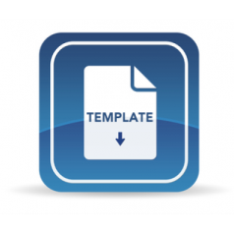

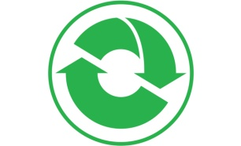



DCAF Overview
An open-source LabVIEW framework for building robust, feature-rich control applications in less time by combining out-of-box functionality, a configuration-based workflow, and clear points for extension.
Scalable and extensible plugin architecture
Develop with plugin templates
Reuse existing plugins
Define and configure plugin parameters
Single point I/O, processing, and data services
Rules for correct-by-construction software
Configure timing and error handling
Optimized for real-time execution
Notes:
The Distributed Control and Automation Framework (DCAF)…
provides a scalable and extensible plugin architecture.
supports users in the development of new plugins with a variety of templates…
…and the framework was designed to allow plugins to be reused easily across projects.
Reuse is easy because each plugin can define configuration parameters which can be specified using a configuration editor. This also allows plugin behavior to change across multiple deployments of the same application.
While applicable to a wide variety of use-cases, the framework was primarily built for applications using a lot of single point I/O: things like control data or industrial communication protocols.
The plugin architecture helps facilitate multideveloper teams,
and the framework handles the intricacies of execution timing and error handling for its users.
Finally, while the framework can run on RT, Windows, and Interact with FPGAs, it was built primarily for applications executing on a real-time OS.

Slide 7
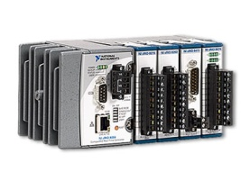
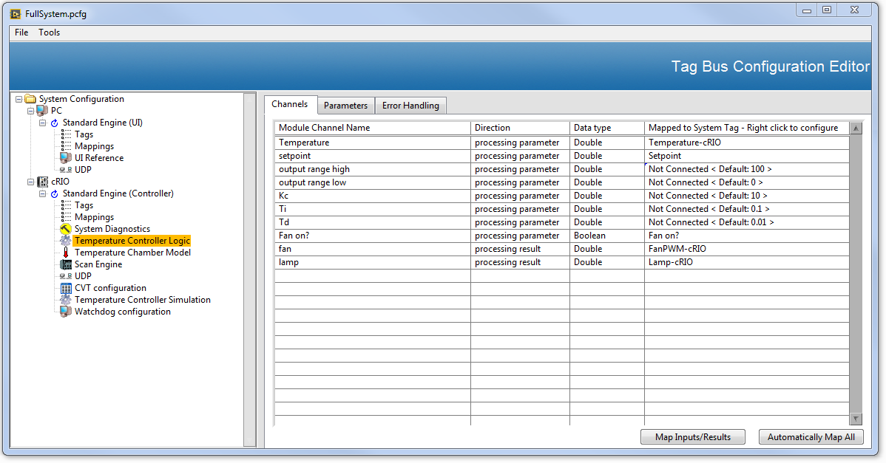


DCAF Architecture
Framework Code
Framework Plugin
Parallel to Framework
Main.vi
Loops for Non-Framework Tasks
Build and reuse plugins
Define plugin parameters and data exchange using a configuration editor
Launch an engine to execute the configuration
Interact with the engine as a background service from your main application
  Change Engine State
  Get/Set Tag Values
Engine Interface Loop
Loops for Non-Framework Tasks
Configuration Editor
Loops for Non-Framework Tasks
Configuration APIs
Engine Command API
Plugin UIs
File API
API Calls
DCAF Execution Engine
Run State
Shutdown
Idle
Tag Bus
Inputs
Process
Outputs
Upkeep
Configuring
Plugin1
Plugin3
Plugin1
Fault Recovery
Plugin2
Plugin4
Plugin5
House-Keeping
Safe State
Notes:
This diagram communicates the major aspects of DCAF. There is a lot of stuff going on in this diagram, so let's walk through it step by step.
The first thing to notice is that there are three places where code executes:the windows Configuration editor on the top left, the main.vi which typically runs on a real time controller (will work on any processor that supports LabVIEW), and the DCAF execution engine which gets launched from the main VI.
There are also three types of code depicted: Code provided by the framework in Blue, framework plugins in light yellow, and code that runs external or in parallel to the framework in Green. The code in blue should generally not be modified by users of the framework. Instead updates can be installed. Framework plugins can either be found and installed from the community, or can be created by end users. Finally, there are no limits or restrictions to what a user can develop outside of the framework on the execution target shown in Green.
Now let's take a look at a typical workflow by traversing this diagram. Starting with the configuration editor, a user will select which prebuilt and validated plugins that they would like to use, as well as configure things like initialization parameters, execution timing, and how data is shared between plugins. All of this information is then stored in a file where it can either be reloaded in the editor, or deployed to a controller for execution.
Once on the controller, APIs are used to read the configuration from the file. Additional configuration APIs are provided such that a configuration can be created or modified at runtime. Once settled, the configuration is used by the engine command API to launch an execution engine with the correct plugins and initialization parameters. This API is also used to transition the engine through its state machine.
Once in the run state, the engine will call the input method for each plugin, then the processs, followed by the output method. Each plugin can implement multiple methods within the engine. The framework also supports the execution of multiple engines within the same target.
Each method is called sequentially, and data exchange between plugin methods is taken care of by the framework using the Tag Bus. This approach ensures predictable execution and eliminates the possibility of race conditions, both of which are very desirable for control applications.
Finally, the engine handles any fault recovery or house-keeping tasks required.
The engine plugins are ideal for things like industrial communication protocols, data services like logging and alarming, and control algorithms like PID. The majority of functionality for most control applications can execute entirely in the form of reusable plugins.
However, if any functionality is needed outside of the framework, a user is free to put that functionality directly in the main VI as another Green loop.
This diagram shows the key difference between an application framework and an application example, template, or sample project. A framework has code that is meant to be used as-is, and has clearly defined extension points designed to simply the development of common tasks.

Slide 8
For Both Beginner and Advanced Developers
Framework Code
Framework Plugin
Parallel to Framework
Beginner Developers:
Reuse existing plugins and create simple plugins
Develop all other functionality as a ‘Green Loop’
Advanced Developers:
Create flexible plugins for use in any application
Customize the editor, engine, or other code
APIs for automation
Contribute on Github
Main.vi
Loops for Non-Framework Tasks
Engine Interface Loop
Loops for Non-Framework Tasks
Configuration Editor
Loops for Non-Framework Tasks
Configuration APIs
Engine Command API
Plugin UIs
File API
API Calls
DCAF Execution Engine
Run State
Shutdown
Idle
Tag Bus
Inputs
Process
Outputs
Upkeep
Configuring
Plugin1
Plugin3
Plugin1
Fault Recovery
Plugin2
Plugin4
Plugin5
House-Keeping
Safe State
Notes:
DCAF can be used successfully by any developer ranging from beginner to advanced.
For beginning developers, everything in blue and many pre-existing plugins in yellow are provided for users our of the box, and they never have to look at the code if they’d prefer not to. Users can install updates to these portions of the framework as they are made available. This greatly reduces the development scope for those users.
Users will likely still have to write some code in yellow and in green, but the framework provides specific templates and documentation to help guide that development.
Any other code can still be created in parallel with the framework if needed so that users don’t have to come up the full learning curve.
For advanced users, the plugin framework model promotes reuse and allows development teams to easily break up their work such that each individual can contribute.
The entire framework is open source, and can be customized or improved by anyone that understands the full scope.
Anything done in the editor can also be done programmatically, allowing advanced users to script out configurations to automate various tasks.

Slide 9
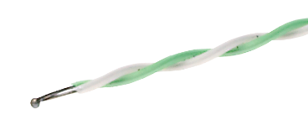

Demo: Simulated Temperature Chamber
Temp. Chamber
Configuration Editor
Simple Execution Template.vi
Framework Code
Engine Interface Loop
Framework Plugin
Engine Command API
Parallel to Framework
File API
DCAF Engine (I/O and Control)
DCAF Engine (UI)
Run State
Run State
Tag Bus
Tag Bus
Inputs
Process
Outputs
Upkeep
Inputs
Outputs
Upkeep
Sim. Temp.
PID Algorithm
Sim.
Lamp
Fault Recovery
UI
UI
Fault Recovery
UDP
UDP
House-Keeping
UDP
UDP
House-Keeping
Notes:
This is the shipping example for the framework. To run the example, install DCAF and search for DCAF in the example finder. The example contains the demo script in its documentation.
First show the simulation and PID algorithm. Explain that UI and UDP are provided out of box.
Dig into the PID algorithm code.
Next open the configuration editor. Show system, target, engine, module hierarchy. Show the connection. Explain that it is open source.
Next show the configuration file.
Finally explain the Simple execution template VI.

Slide 10

Building an Embedded Control Solution
Design
Develop
Validate
Deploy
Maintain
Notes:
After requirements have been gathered, and any required prototyping completed, the next step in any project of decent size is to design the software.

Slide 11
Who is DCAF for?
Application Type: Control and Automation
Single-point I/O, processing, and services
Outputs provided in real-time
Not Real-Time Test
Not Monitoring or Data Acquisition
Scope Type: Deployed Solution
Built product (internal or external)
Project time measured in months
Not a Simple Demo/POC
Tool Type: LabVIEW
Some LabVIEW experience needed
Not C/C++ developers
Not Ladder/61131 developers
Control
Solution
LabVIEW
Notes:
DCAF was designed specifically to help people build better control solutions in LabVIEW. There are plenty of other ways to take advantage of the framework and its components in other applications areas, but control is the main target today. The last thing we want is for anyone to use the framework for the wrong job.

Slide 12
Application Architecture Design
Framework Code
Framework Plugin
Parallel to Framework
Plugin Design:
Which functionality goes into plugins?
How many are there?
How do they interact?
How will each plugin work?
Main.vi
Loops for Non-Framework Tasks
Engine Interface Loop
Loops for Non-Framework Tasks
Configuration Editor
Loops for Non-Framework Tasks
Configuration APIs
Engine Command API
Plugin UIs
File API
API Calls
Standard design work required for ‘Non-Framework Tasks’.
Waveform acquisition
Data streaming
Event response
Other
DCAF Execution Engine
Run State
Shutdown
Idle
Tag Bus
Inputs
Process
Outputs
Upkeep
Configuring
Plugin1
Plugin3
Plugin1
Fault Recovery
Plugin2
Plugin4
Plugin5
House-Keeping
Safe State
Notes:
DCAF does a lot to help simplify the design process. First, a lot of the design is provided out of box. Secondly the plugins have clearly defined interfaces that lend themselves to a simple methodology or formula for design. Thought is still required, but the constraints make it much easier to arrive at a good solution.

Slide 13
Building an Embedded Control Solution
Design
Develop
Validate
Deploy
Maintain
Notes:
Ok, so you’ve chosen to use DCAF as part of your design…now how does it help with development?

Slide 14




Core DCAF Engine Out-of-Box Functionality
Flexible and configurable execution timing
Error handling based on error categorization
State management
Data communication and shuttling
Notes:
The engine provides many features without needing to do any programming.

Slide 15
Reuse Existing Framework Plugins
I/O
FPGA and Scan Engine/Variable Engine
Modbus, PROFIBUS, EtherNet/IP, and other protocols
Data Services
Data Processing/Application Logic
Current Value Table (CVT) interaction
PID
Scaling
UDP Engine-to-Engine Communication
Web Service
TDMS Data Logger
Alarming
1. Protocol Gateways
2. Hardware Abstraction
3. Data Processing
4. Data Services
Notes:
Reuse is one of the biggest benefits of DCAF. I/O, Scaling, Alarming, Logging, and much more functionality is provided out of box through configuration.

Slide 16
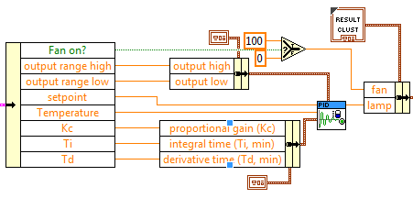
Develop Fixed-Logic Plugins Fast
Notes:
This is a screenshot of a plugin VI. Plugins that have static inputs and outputs can literally be created in as little as a single VI.

Slide 17
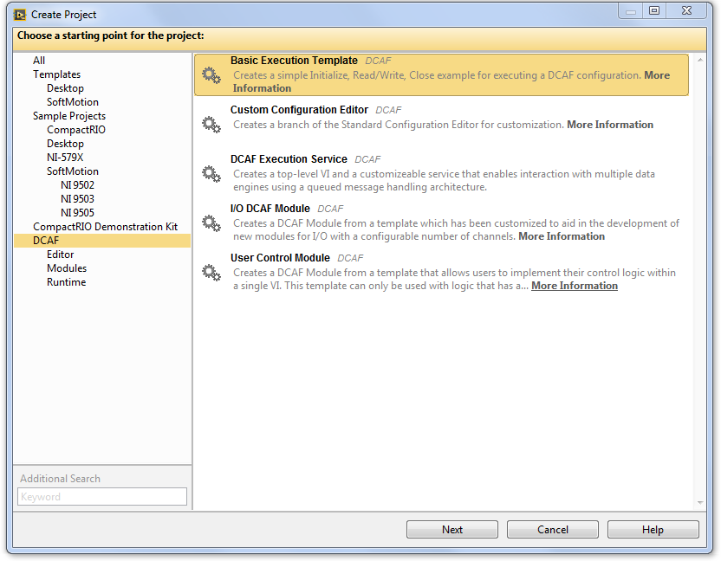
Project Templates for DCAF Main Application
Update with new screenshots!
Notes:
Application templates exist in addition to the plugin templates.

Slide 18
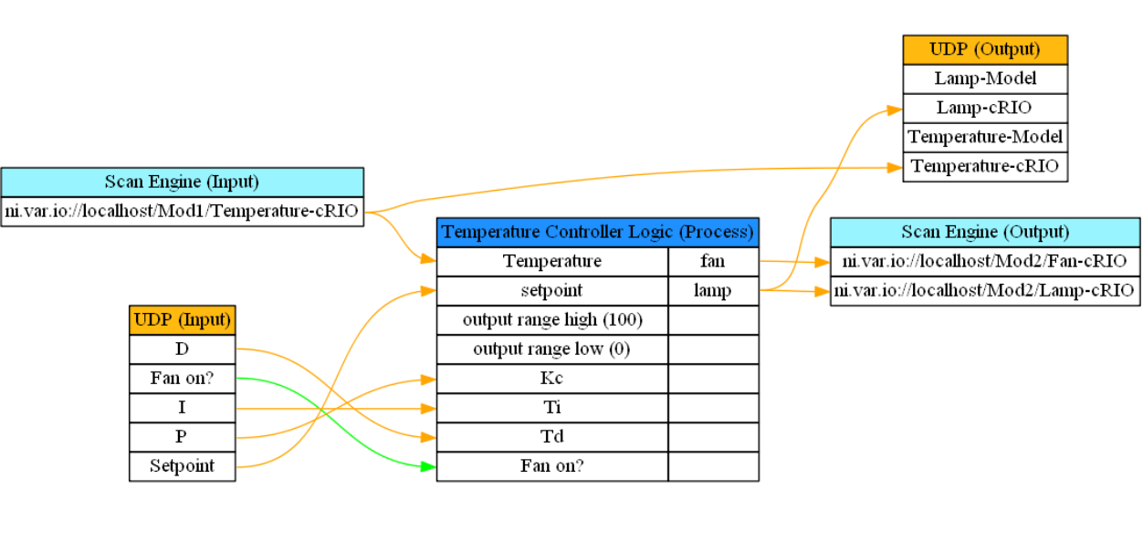
Collaboration
Configuration Editor aids in communication:
  Define interfaces in advance
  Generate system documentation
Develop plugins in parallel
Develop code without hardware
Collaborate with a larger community
Notes:
The framework also does a lot to help with development in team-based settings. The configuration editor helps with system documentation and communication. The framework makes parallel development with multiple developers much more feasible. There are also opportunities to collaborate with other developers outside of your internal development team.

Slide 19
Building an Embedded Control Solution
How many loops did you program?
Design
Develop
Validate
Deploy
Maintain
Notes:
Ok. So you just finished development. How many while loops did you program?
Ok, now how do we validate this stuff?

Slide 20
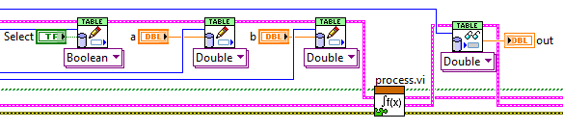
Validate Plugins Individually Before Assembling
Possible to create test benches for each plugin
Create system configurations specifically for validation
Use the engine for execution benchmarking
Notes:
All plugins can be unit tested as-is, and some simple tests are provided as part of the plugin sample projects.
Imagine trying to test the various loops in your main application.

Slide 21
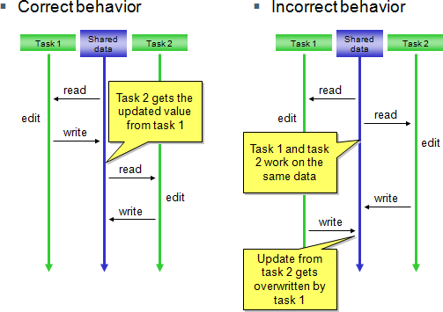
Prevent Unexpected Behavior During Assembly
DCAF Engines help prevent unexpected behavior including:
Race conditions
Deadlocks
Starvation
Memory allocations
The Configuration Editor also helps prevent configuration errors.
Notes:
Unit testing is great for validating logic, but often fails to identify issues caused by interactions from various sections of code. Fortunately the framework has solutions for many of those as well.
Sequential execution and single-writer within the engine completely eliminate the possibility of race conditions for much of the code.
Single-threaded, non-blocking execution helps to eliminate the chances of deadlocks.
Users rarely program loops, and therefore don’t need to remember to add loop timing.
The framework allocates static memory for execution. There are ways to break this, but the risk is reduced.
Configuration errors are a huge cause for unexpected behavior. The framework allows users to define invalid configurations, and warn users when the occur. This is not commonly done with INI, Excel, or other simple forms of configuration. The graphical nature of the configuration also makes it much easier to spot mistakes.

Slide 22
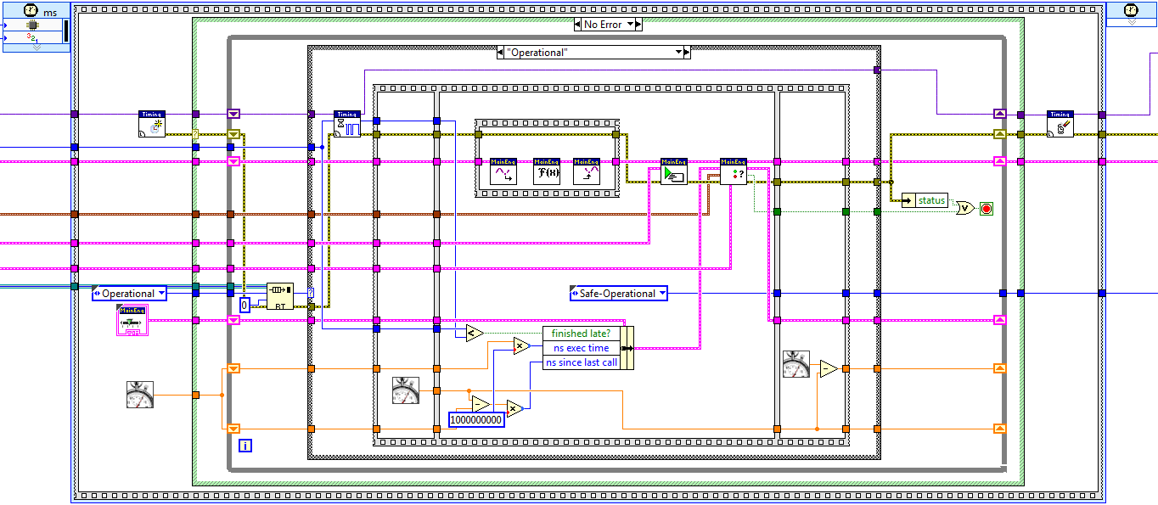
DCAF Execution Engine
Notes:
The source code for the engine isn’t as scary as you might think. It follows a pretty straightforward sequence of steps:
Check for a message to stop.
Wait for next clock source to fire.
Sequentially read all inputs and store data on the bus.
Process data and store on bus, then process again and store on the bus, then process again. Etc.
Send data to all output locations sequentially.
Choose which plugins execute on the next iteration.
Check for errors and handle them.
Sequential execution provides predictable behavior.

Slide 23
Building an Embedded Control Solution
Design
Develop
Validate
Deploy
Maintain
Notes:
You are ready to go deploy. Now what?

Slide 24

Deployment Commissioning
Add new functionality or customize existing functionality through a single configuration file.
Change control gains
Calibrate sensor readings
Map data from new inputs
Turn functionality on and off
Notes:
Embedded applications often require specific tuning for each deployment. The configuration editor in DCAF can greatly simplify this process.

Slide 25
Building an Embedded Control Solution
Design
Develop
Validate
Deploy
Maintain
Notes:
Ok now it is deployed, DCAF can still help simplify maintenance.

Slide 26

Built-in Diagnostic Capabilities
Error reporting
Probes for viewing local tag data
CPU and memory reporting
Hooks for new capabilities

Slide 27
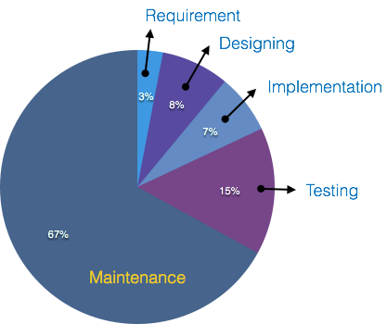
Shared Maintenance Through Open Source Software
If you upstream framework improvements, support overhead is shared by all users
When others enhance or extend the framework, you benefit for free
More users means more people testing and reporting issues with the code
Notes:
The software maintenance burden for larger applications is often severely underestimated. I haven’t often seen it at 67% of development time, but it is often much more than expected. The open source nature of DCAF allows users to spread that maintenance burden out over the full development community, reducing the amount they must take on themselves.

Slide 28
Now for the Next Project!
Potentially reuse one or more plugins on the next project
No longer pay the ‘onramp’ penalty
Finish future projects in less time than the first
Design
Develop
Validate
Deploy
Maintain

Slide 29
Common Questions
How good is the performance?
  Code refactored to use the framework has run up to 15X faster
  Expect a 1kHz rate from a full cRIO chassis on a value line controller
Do I have to learn Object Oriented Programming (OOP)?
  Knowledge of OOP is not required to use the framework
  Basic understanding may be required for troubleshooting
What about FPGAs?
  DCAF only executes on processors, plugins exist for FPGA interaction
How do I debug the application?
  Everything is open LabVIEW, standard debugging techniques apply
  Refer to the community for additional tips and tricks

Slide 30

DCAF Drawbacks
Software load and deployment times may be slow
  Can be 2 minutes or greater for each controller
EXE build issues can be common, leave time at the end of your project
Ramp up time required for new tools and workflow
  Expect to need a few days to a few weeks depending on existing LabVIEW experience and DCAF use case complexity
The framework is large, some level of trust is required
DCAF is not a NI product! Support is only available from online forums

Slide 31

New DCAF Features for NI Week 2016
Completed:
Revamped configuration user interface
Improved plugin templates
New scaling capabilities
Apache 2.0 licensing
New name
Tools network availability
New community with videos and documentation
In Development:
Syslog diagnostics
Additional scaling plugins
Improved web service plugin
Shared memory plugin
Auto-scheduling
Benchmarking capabilities
More examples
Notes:
In addition to a formal merge of tool chains, DCAF also comes with the following new things…

Slide 32
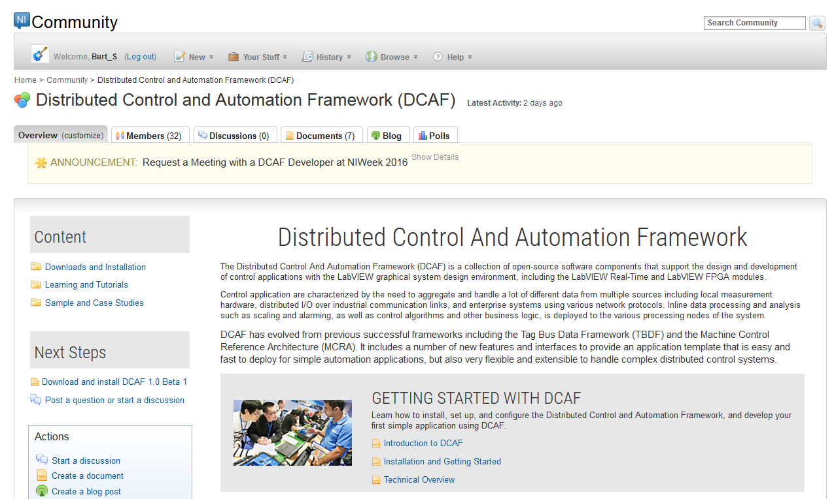

Slide 33

Getting Started with DCAF
Learn more about DCAF at ni.com/dcaf:
  Community includes videos, documentation, hands-on, examples, and more!
Install directly from NI Tools Network using VI Package Manager
  Visit the DCAF booth in the Tools Network Pavilion!
Find additional development tools at ni.com/referencedesigns
This is not a product, it is an open source project. Find support on the community and submit issues to Github.
https://github.com/LabVIEW-DCAF
Contributors welcome!
Notes:
To learn more about DCAF on your own, visit our community page.
Again these are open source tools. Partners and customers are welcome to contribute to the framework on Github.
Finally, please feel free to contact me with any other questions.
Thank you for your time. The DCAF community looks forward to working with you to make 2016 a great year for embedded!

